Slide 1
Recommender Systems
Taxonomy of Recommender Systems
Item-context and User Rating Matrix
Quality of Recommender Systems with Online/Offline Evaluation Techniques
Filtering Types and Techniques
Important Concepts of Recommender Systems
Shahzaib Hamid

Slide 2
Overview
Taxonomy of Recommender Systems
Item-context Matrix
User-Rating Matrix
Inferring Preferences
Quality of Recommender Systems
Online and Offline Evaluation Techniques
Dataset Partitioning
Overfitting
Error Matrix
Content-based Filtering
Collaborative Filtering
User-based and Item-based Collaborative Filtering
Model-based and Memory-based Collaborative Filtering

Slide 3
Taxonomy Recommender Systems
Algorithms
Non-personalized
Personalized
Content-Based Filtering
Collaborative Filtering
User Based
Item Based
Matrix Factorization
Others
Context-Aware
Hybrid Side Information
-Factorization Machine

Slide 4
Item-Context Matrix (ICM)
One important input to a recommender system are the list of items and their attributes
ICM is used to describe such problems
Rows in the item content matrix represent items and columns represent attributes
The values in the item content matrix are in binary format, either zero or one
If an item contains a specific attribute, the corresponding value in the matrix will be set to one, zero, or otherwise
Let's have an Example

Slide 5
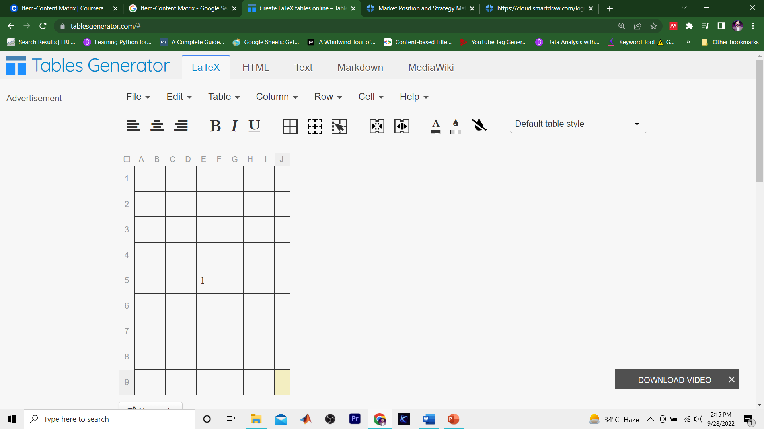
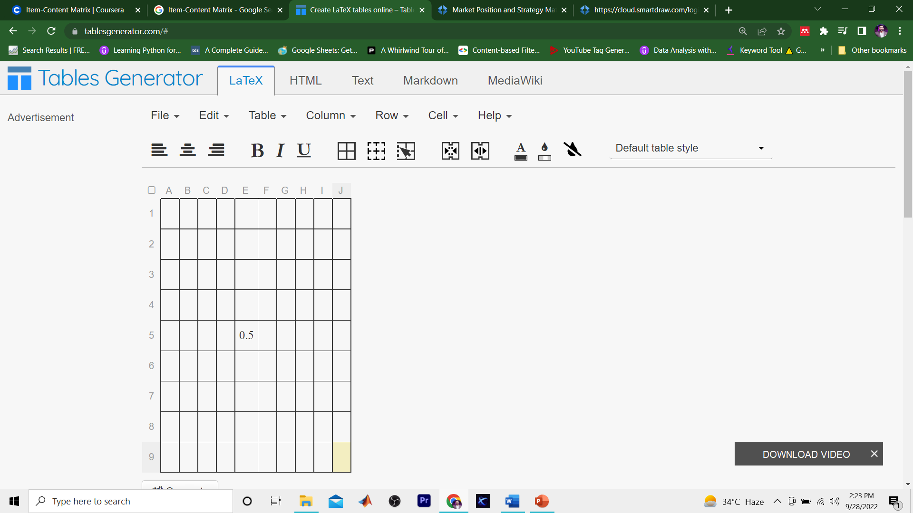






Item-Context Matrix (ICM) - Example
Attribute a
Tom Cruise
Stan Lee
Top Gun
Mavrick
Item i
The Avenger

Slide 6


User-Rating Matrix (URM)
Item i
i
rui Є {0,1}←implicit
rui Є {1,2,3,4,5}←explicit
Typically, URM density <0.01 %
User u
R= u
Netflix, URM density ≈0.002 %
MovieLens, URM density ≈0.005 %
5 is the rating which user gave to the item

Slide 7
Inferring Preferences
There are different ways to collect user opinion
Implicit Ratings
Explicit Ratings
Rating Scale
Even Rating Scale
Odd Rating Scale
Rating Distribution

Slide 8
Quality of Recommending System
Quality of RS
Topic Diversity
Novelty
Serendipity
Temporal Diversity
Temporal Awareness (Reactive; Trending)
Temporal Awareness (Reactive; Seasonal)
Temporal Awareness (Proactive)
Location Awareness
Risk Awareness
Context Awareness
Critique Acceptance
Curation
Knowledge Based
Social Awareness
Privacy
Protection from Malicious Voting

Slide 9
Evaluation Techniques for Recommender Systems
Online Evaluation
Offline Evaluation

Slide 10
Online Evaluation Techniques
Direct User Feedback
Simple questionnaires or surveys are used to ask from user
It has two problems
Size of the sample should be meaningful
Opinion of the use could not be reliable
A/B Testing
Behavior of the user is analyzed online, and A/B testing is applied
User behavior is compared
Controlled Experiments
A mockup application is made available to the users.
Issue: User cannot be the real user.
Crowed Sourcing
It asks people to volunteer to test and review answers by giving them compensations

Slide 11
Offline Evaluation Techniques
It has few important aspect
Task
Dataset
Partitioning
Metrics

Slide 12
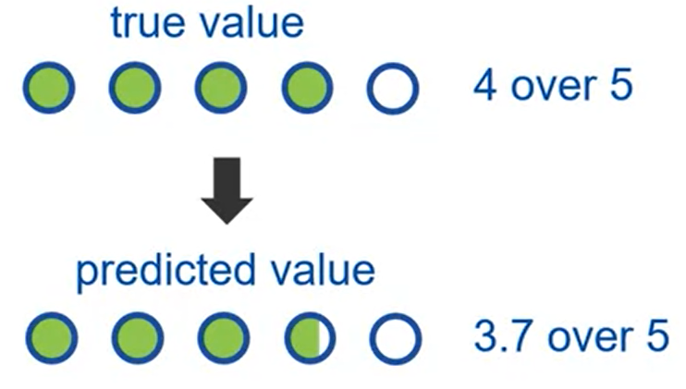
Offline Evaluation: Task
Rating Prediction
Goals is go to as near as to the true value

Slide 13
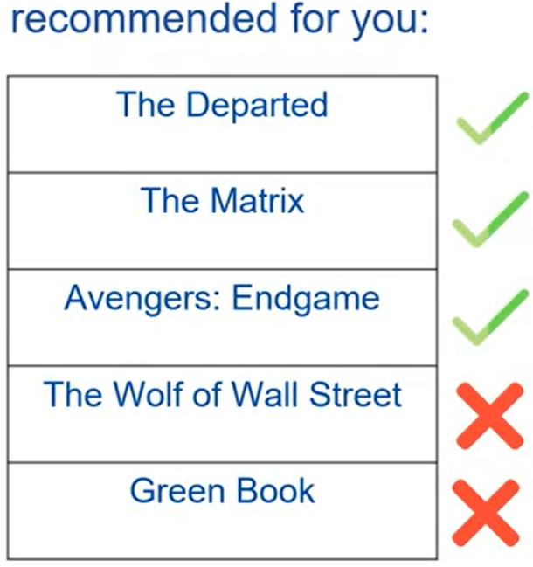
Offline Evaluation: Task
Top N-Recommendation

Slide 14
Offline Evaluation: Data
Data represents all the information available
Dataset is always represented by URM
We know very limited information of all ratings
Ratings are classified into part
Relevant
Non-relevant
Dataset also contains unknown ratings

Slide 15
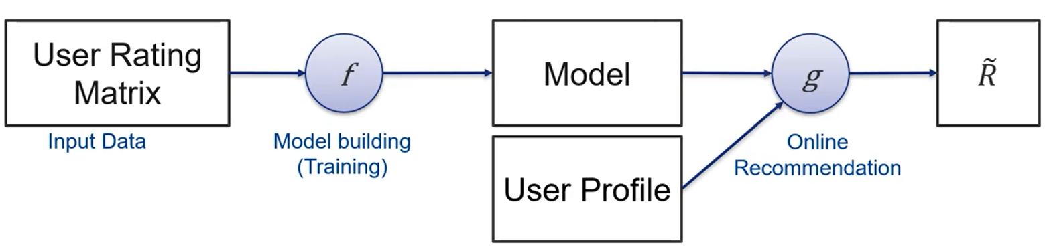
Data Partitioning
Model=ƒ(URM)
Estimated Ratings = g(Model, user profile)

Slide 16
Data Partitioning
Model=ƒ(URM)
Estimated Ratings = g(Model, user profile)
Example:
Model = Top Gun is like The Avengers
user profile = Timmy likes Top Gun
Recommendation ↔ True opinion of the user

Slide 17
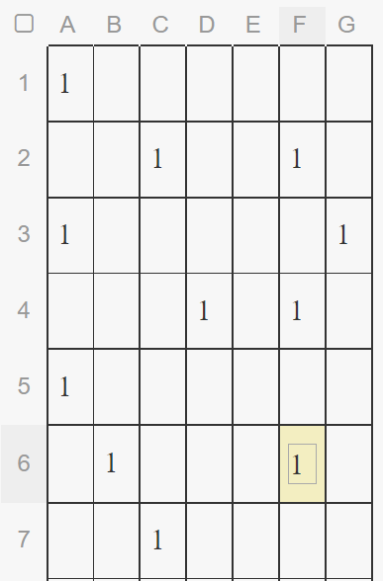
Data Partitioning (Hold Out of Rating)
Model=(X)
Estimated Ratings = (Model, Y)
Estimated Ratings ↔ Z

Slide 18
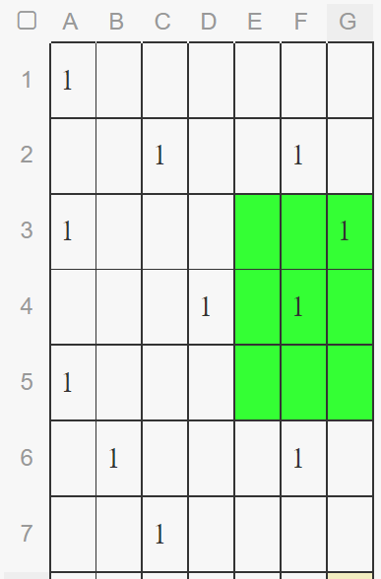

Data Partitioning (Hold Out of Rating)
Model=(X)
Estimated Ratings = (Model, Y)
Estimated Ratings ↔ Z
Z
Z = testing (hidden ratings)

Slide 19
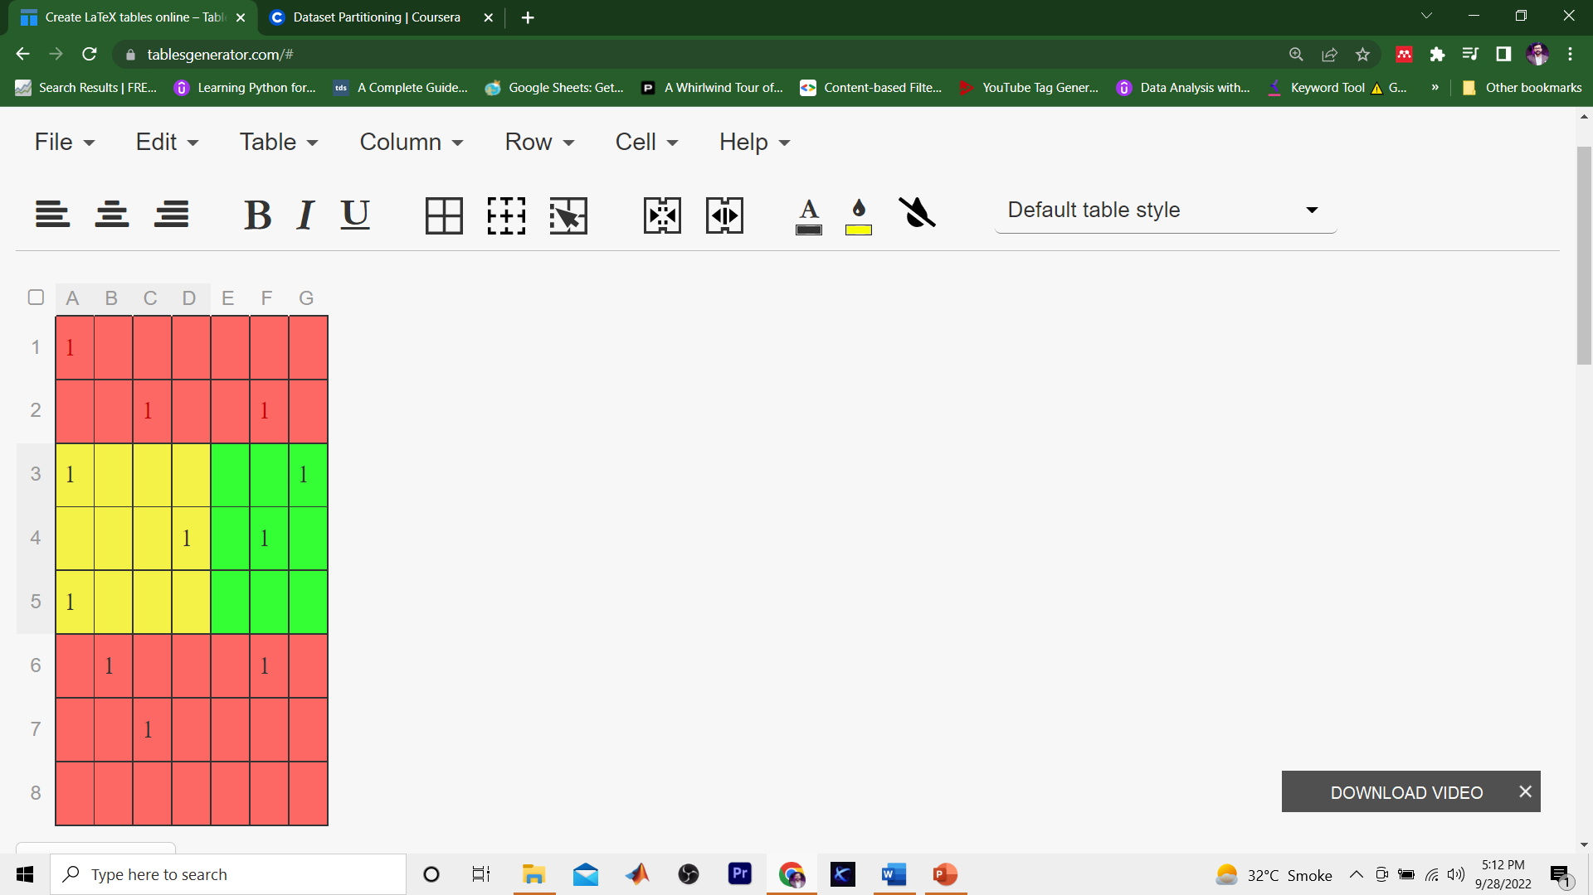
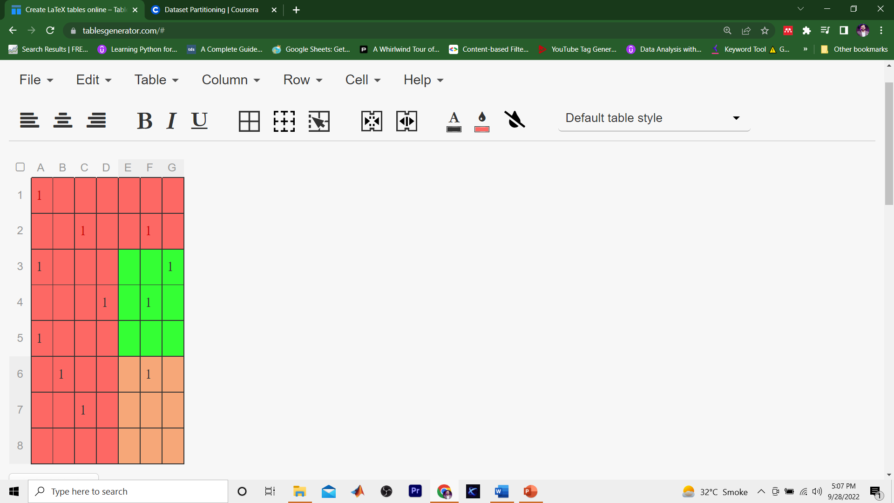


Data Partitioning (Hold Out of Rating)
Model=(X)
Estimated Ratings = (Model, Y)
Estimated Ratings ↔ Z
Y
Z
X
Z = testing (hidden ratings)
X = training
Y = testing ( user profile)
Y belongs to X

Slide 20
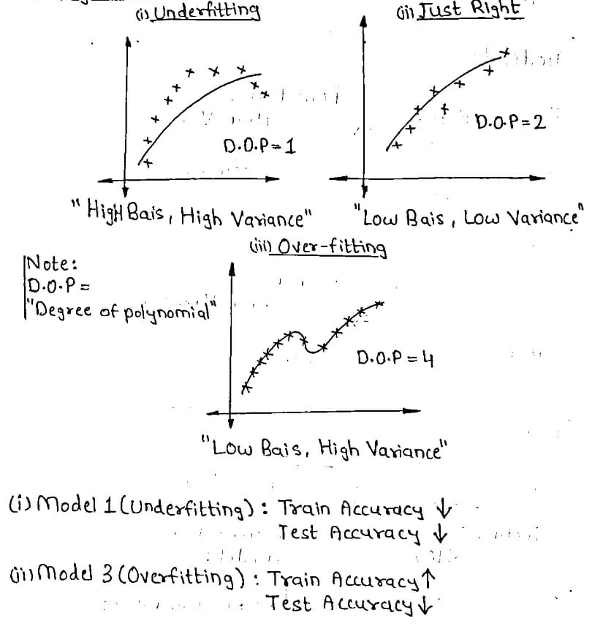
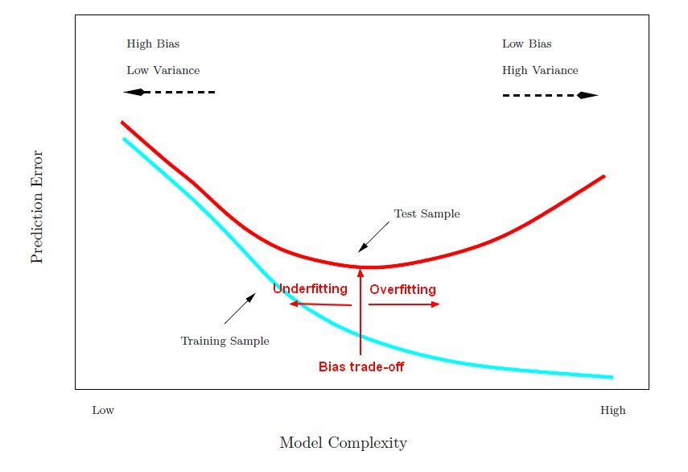
Important Parameters in Recommender Systems
Bias
Variance
Underfitting
Overfitting

Slide 21
Quality Matrix in the Recommender Systems
Error Metrics
Classification Metrics
Ranking Metrics
Classification and Ranking Matrix will be discussed in Next Module

Slide 22


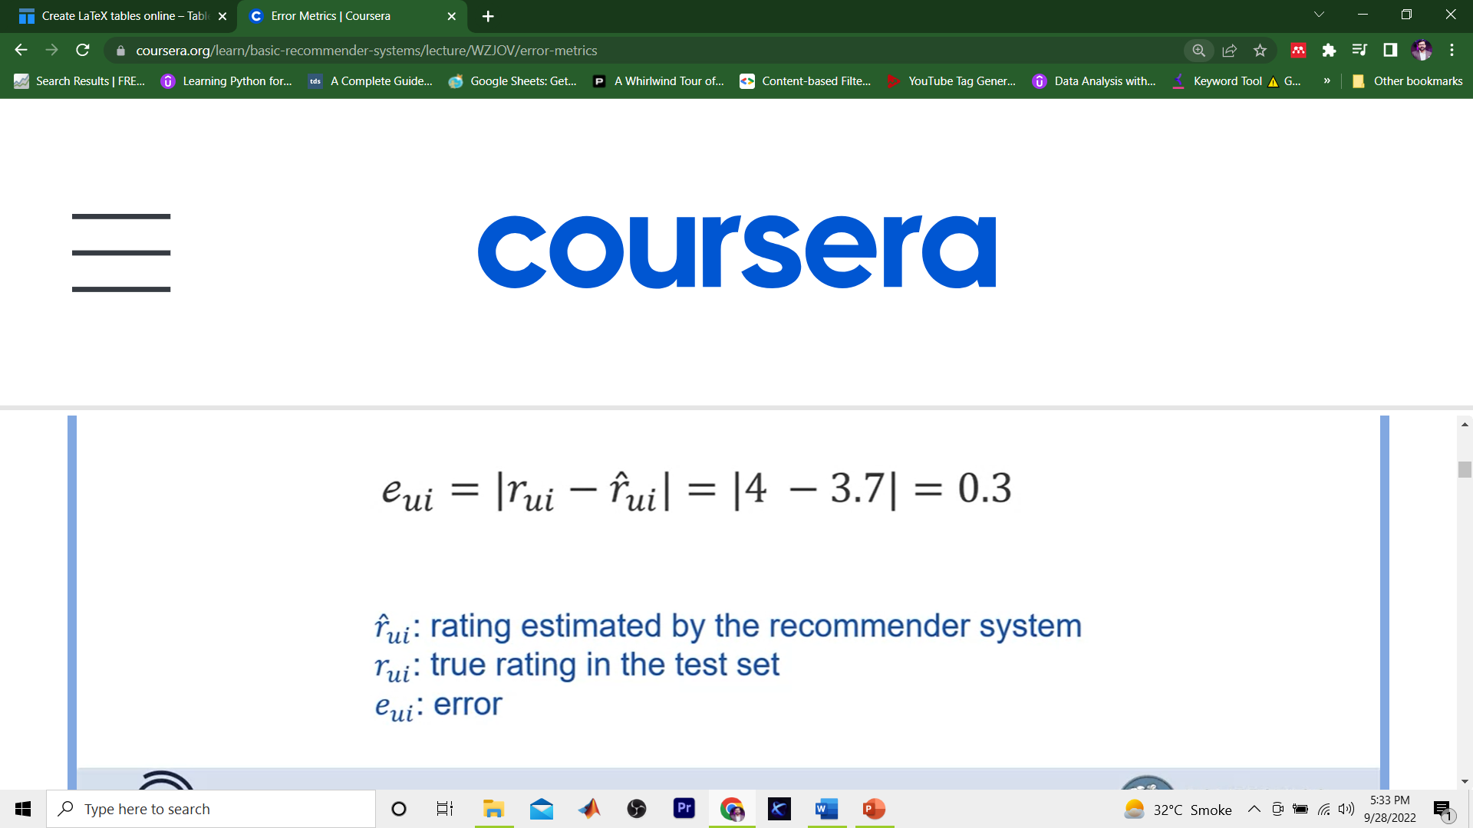
Error Matrix

Slide 23
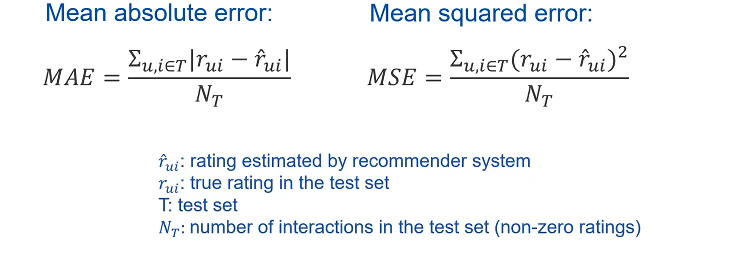
Error Matrix

Slide 24
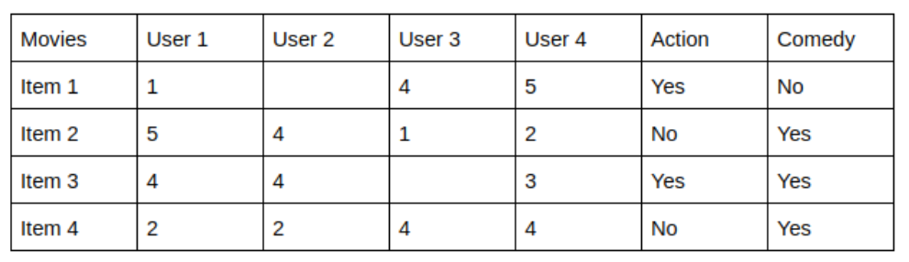
Content-Based Filtering
Content-Based recommender system tries to guess the features or behavior of a user given the item’s features, he/she reacts positively to.
We can know which users like which genre, as a result, we can obtain features corresponding to that user, depending on how he/she reacts to movies of that genre.
Content-based filtering does not require other users' data during recommendations to one user.

Slide 25
Pros & Cons: Content-Based Filtering
Pros:
The model doesn't need any data about other users, since the recommendations are specific to this user. This makes it easier to scale to a large number of users
The model can capture the specific interests of a user, and can recommend niche items that very few other users are interested in.
Cons:
Since the feature representation of the items are hand-engineered to some extent, this technique requires a lot of domain knowledge. Therefore, the model can only be as good as the hand-engineered features.
The model can only make recommendations based on existing interests of the user. In other words, the model has limited ability to expand on the users' existing interests.

Slide 26
Collaborative Filtering
Collaborative filtering filters information by using the interactions and data collected by the system from other users.
It’s based on the idea that people who agreed in their evaluation of certain items are likely to agree again in the future.
Most collaborative filtering systems apply the so-called similarity index-based technique.
Collaborative-filtering systems focus on the relationship between users and items.
The similarity of items is determined by the similarity of the ratings of those items by the users who have rated both items.

Slide 27
User-Based Collaborative Filtering
User-Based Collaborative Filtering is a technique used to predict the items that a user might like on the basis of ratings given to that item by the other users who have similar taste with that of the target user.
A specific application of this is the user-based Nearest Neighbor algorithm.
Steps to Compute it:
Finding the similarity of users to the target user U.
Prediction of missing rating of an item

Slide 28
User-Based Collaborative Filtering
Pros
Easy to implement.
Context independent.
Compared to other techniques, such as content-based, it is more accurate.
Cons
Sparsity: The percentage of people who rate items is really low.
Scalability: The more K neighbors we consider (under a certain threshold), the better my classification should be. Nevertheless, the more users there are in the system, the greater the cost of finding the nearest K neighbors will be.
Cold-start: New users will have no to little information about them to be compared with other users.
New item: Just like the last point, new items will lack of ratings to create a solid ranking.

Slide 29
Item-Based Collaborative Filtering
It was first invented and used by Amazon in 1998.
Rather than matching the user to similar customers, item-to-item collaborative filtering matches each of the user’s purchased and rated items to similar items, then combines those similar items into a recommendation list.
Steps to Compute it:
Firstly, similarities between items are computed.
Secondly, based on the computed similarities, items similar to already consumed/rated are looked at and recommended accordingly.

Slide 30
Model-Based Collaborative Filtering
Model-based collaborative filtering provides recommendations by developing a model from user ratings.
Model-based filtering can also use implicit information by observing the habits of users, such as music played, applications downloaded, websites visited, or books read.
To develop a model, there are two approaches that can be used, which are probability approach or rating prediction
The modeling process is conducted by machine learning techniques such as classification, clustering, and rule-based approach
However, model-based approach requires a great resource, such as time and memory, to develop the model and may lose information when using dimensionality reduction

Slide 31
Memory-Based Collaborative Filtering
Memory-based collaborative filtering utilizes the entire user-item data to generate predictions.
The system uses statistical methods to search for a set of users who have similar transactions history to the active user.
This method is also called nearest-neighbor or user-based collaborative filtering.
Three processes can be applied on it
Choosing other users that are similar to a user
Predicting rating of the item i to a user by calculating the results of aggregating similar users
Providing recommendations based on the results predicted

